Slide 1
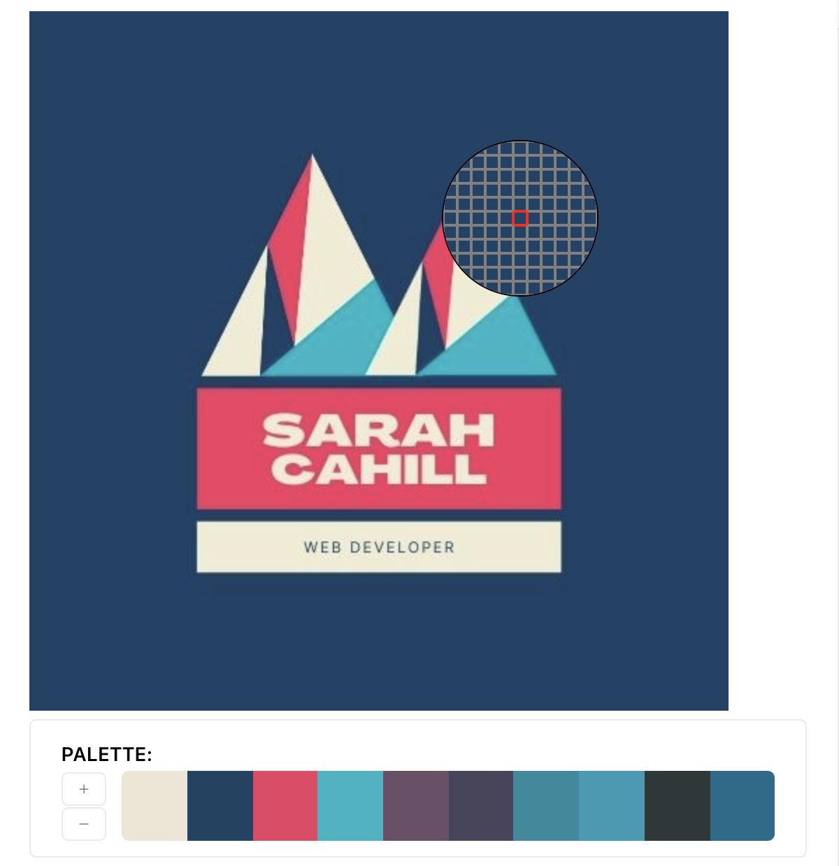
Sarah Cahill
Portfolio

Slide 2


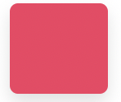
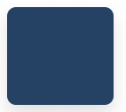
Logo and Colour Scheme
Logo created in Canva, provided colour palette.
HEX #00b7c5
HEX #f43c62
HEX #f0ecd3
HEX #f43c62
Image in jpg, png, gif and mp4 format to allow flexibility for utilising images.

Slide 3
Page Plan & Site Map
Home page, which links to:
About
Blog
Resume
Contact
Aim was for a clean, corporate design. Design palette aims to provide consistency throughout pages.
Each page has a drop down menu to link back to other pages (does not include own page link) for ease of use navigating.
Each page includes the same footer at end of page.

Slide 4
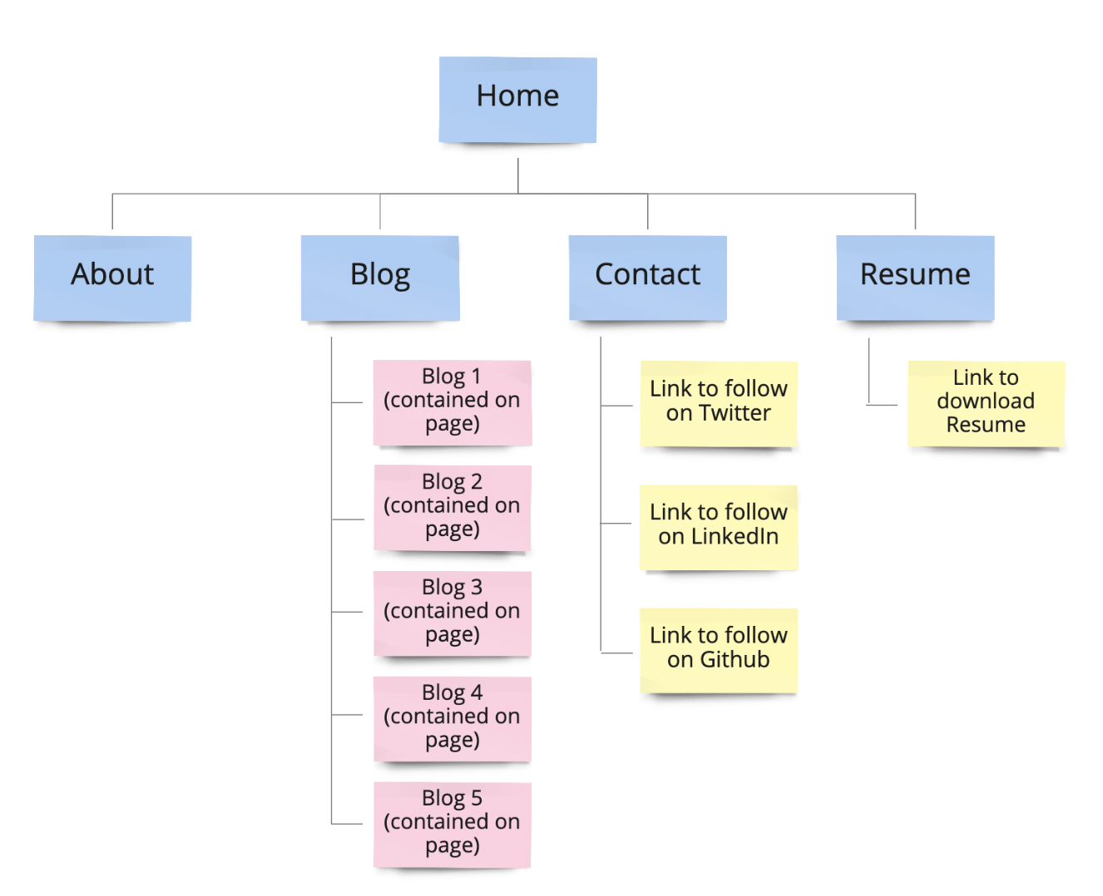
Page Plan & Site Map

Slide 5
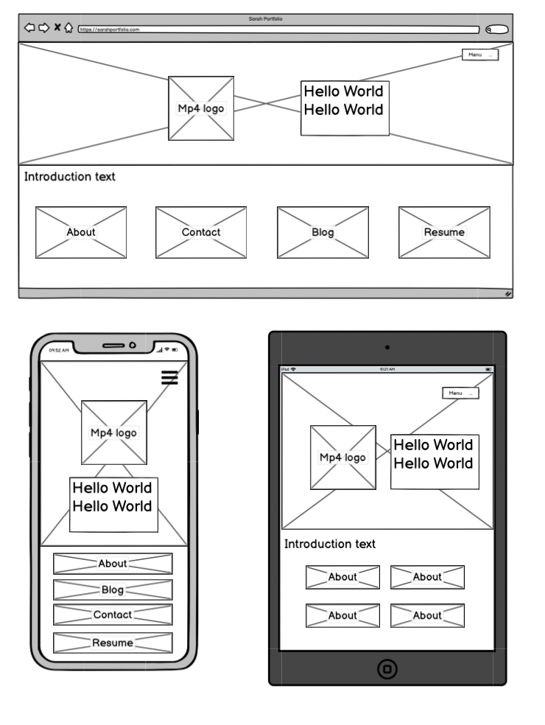
Home Page
Homepage aims to provide comprehensive overview of whole site and a stylistic introduction.
Uses drop down menu.
Provides additional links to four other pages (as well as menu bar).
Bottom buttons change depending on devices – row in desktop, column in mobile, and grid in ipad.

Slide 6
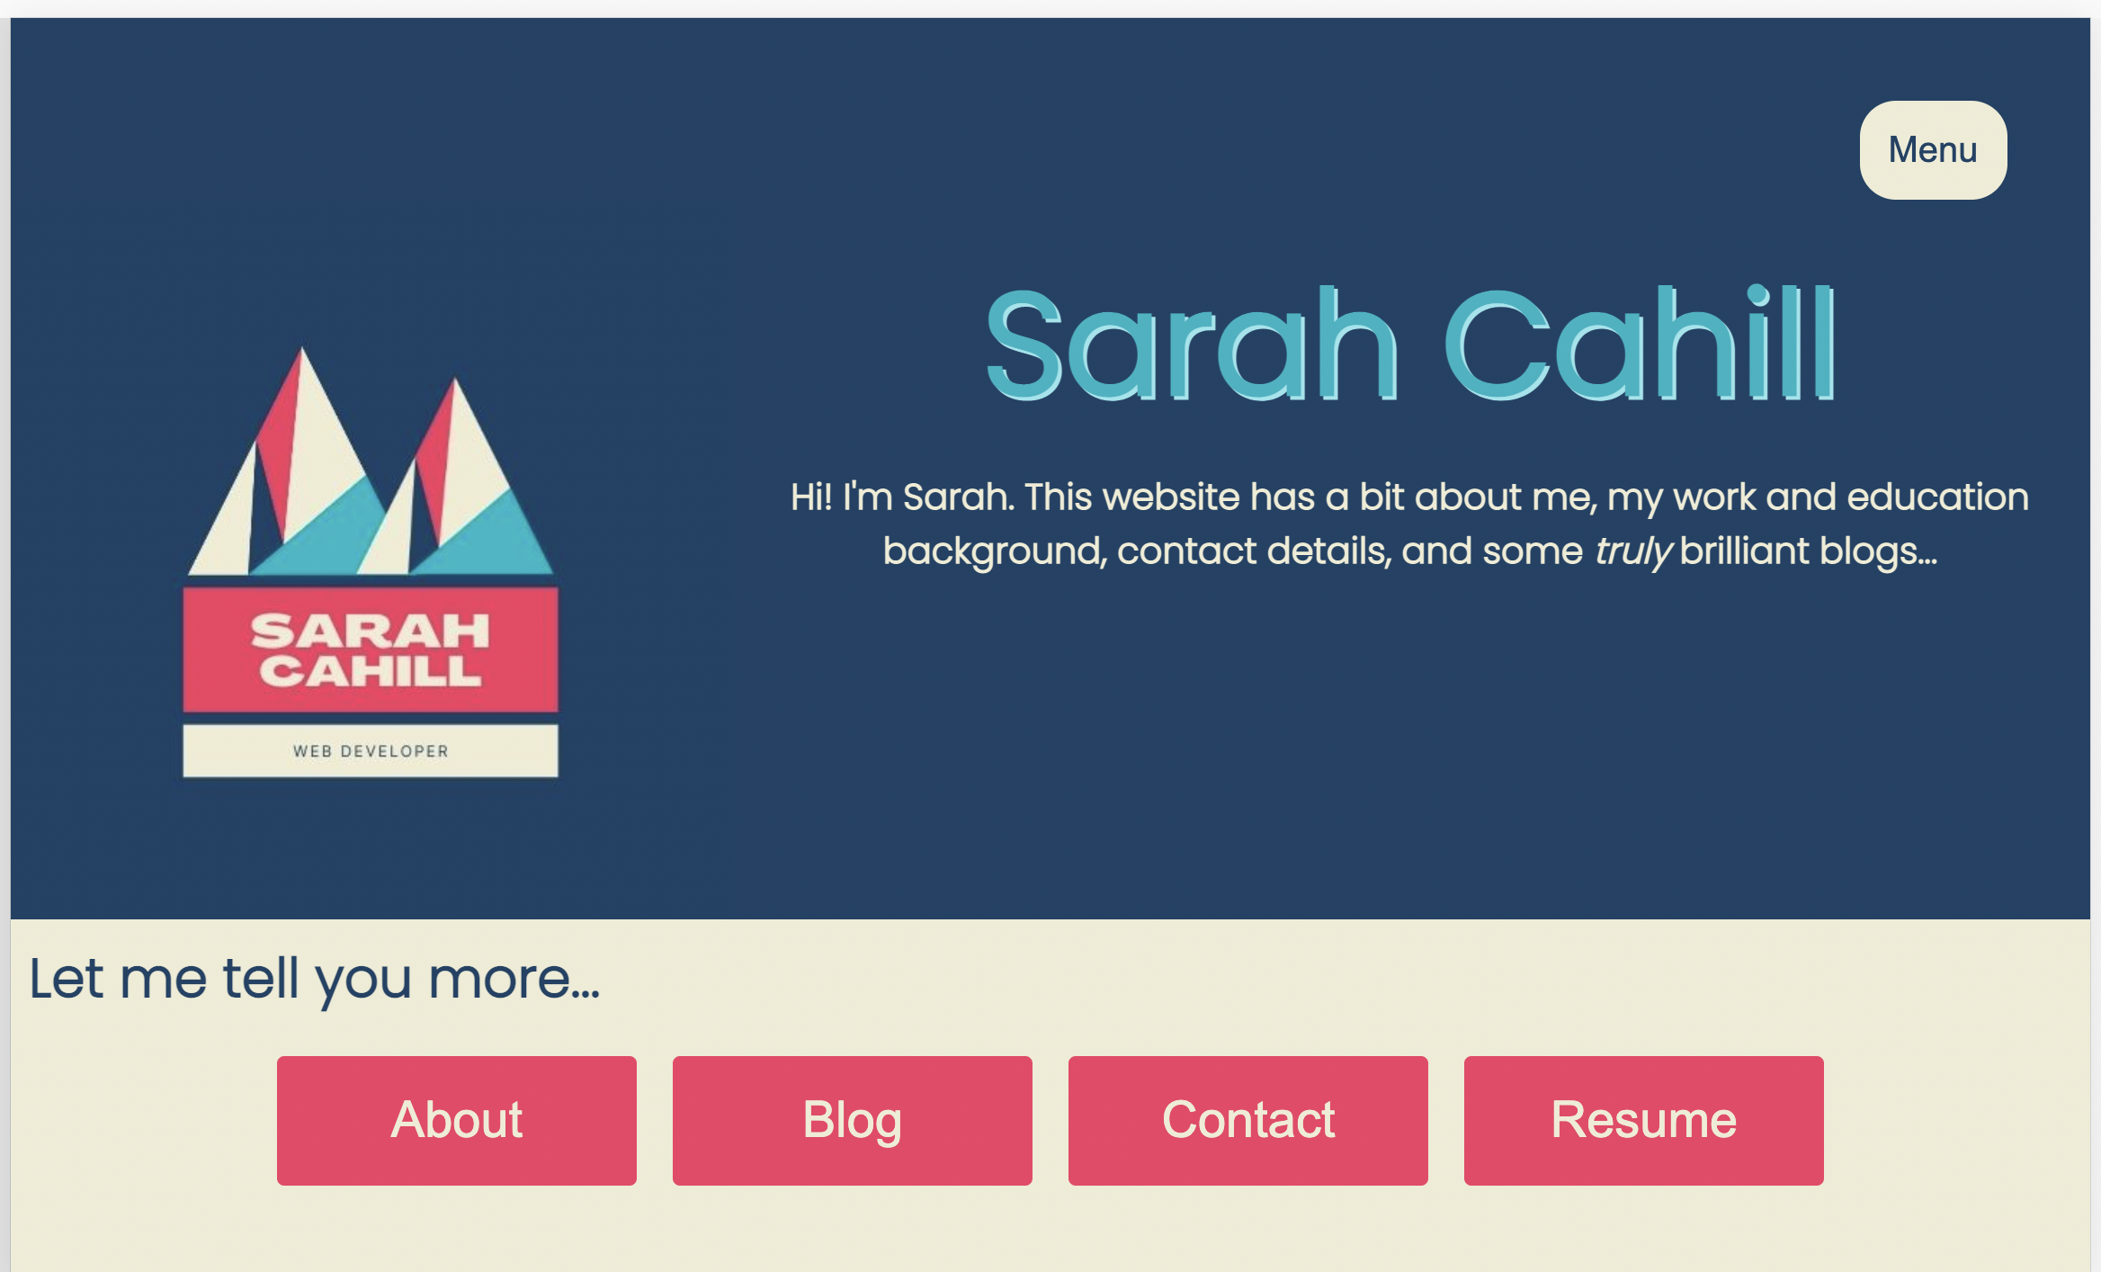
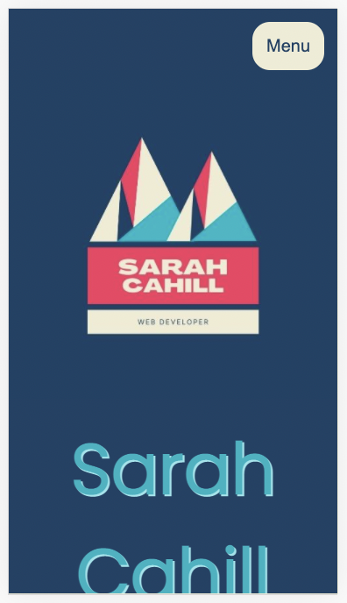
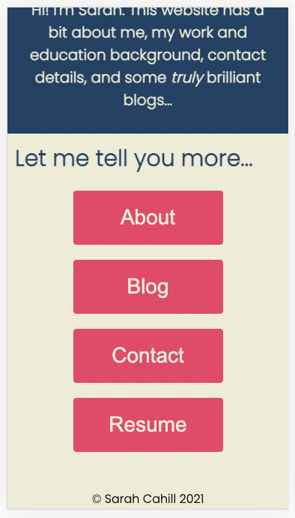

Home Page
Started off with horizontal page menu, but switched to drop down to avoid repetition on page. Menu has pointer hover and highlight hover on pages (in a 50% opacity). Menu links open to same tab.
Buttons at bottom with highlighted hovers. These links open to new tabs for ease of browsing.
Did consider logo as a mp4, but decided too distracting so went with jpg.

Slide 7
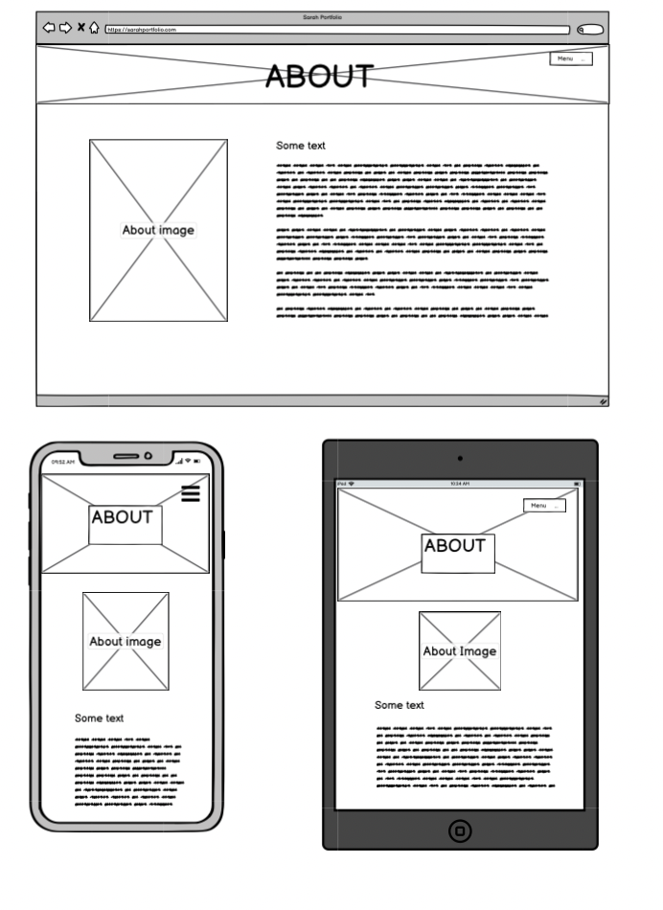
About Page
Very simple page
Includes picture and a brief blurb
Layout changes depending on device size.

Slide 8
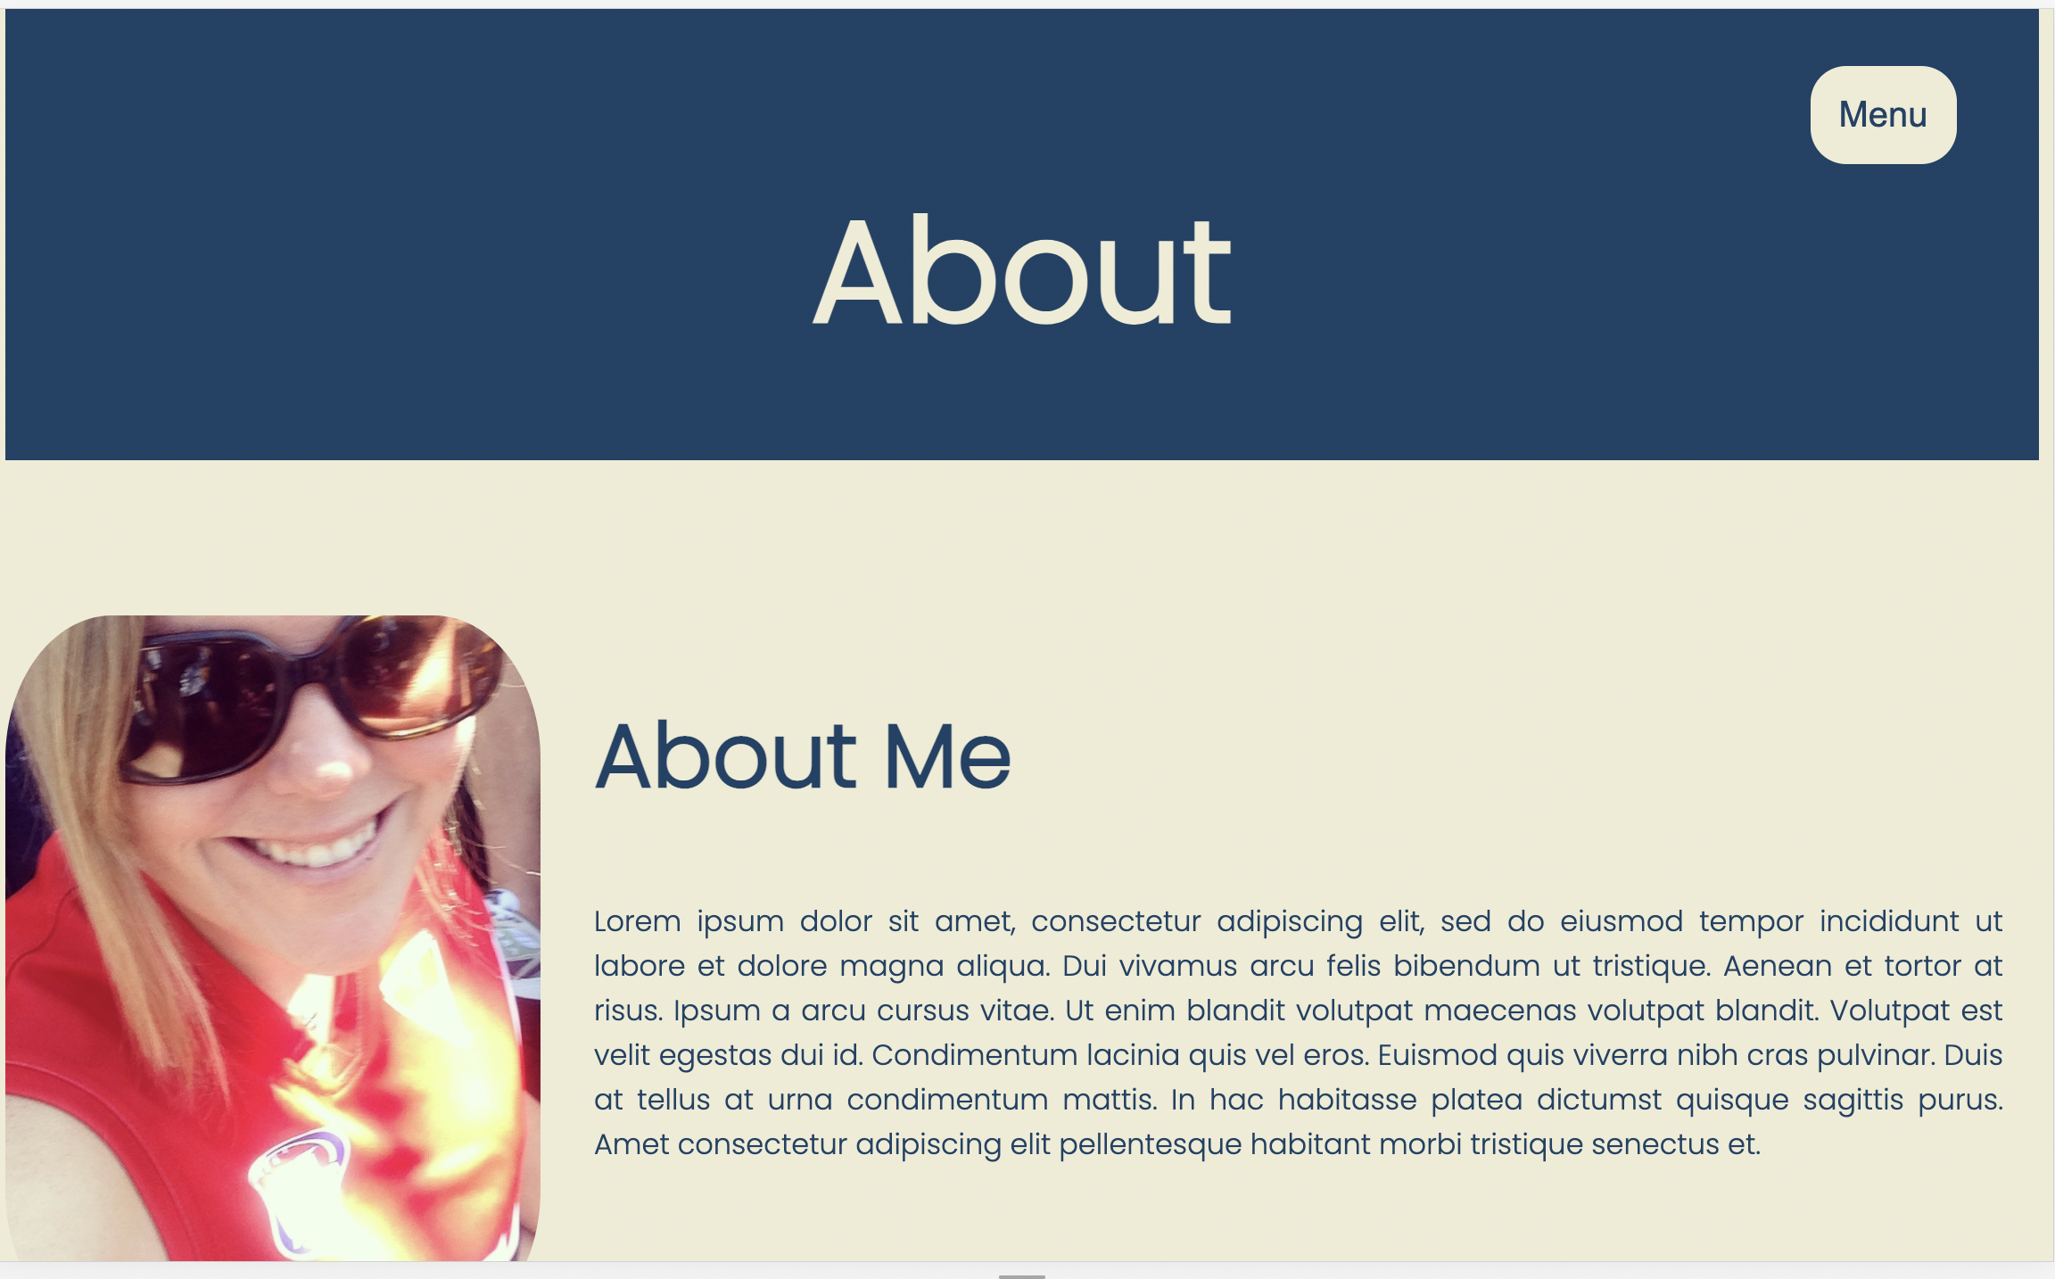
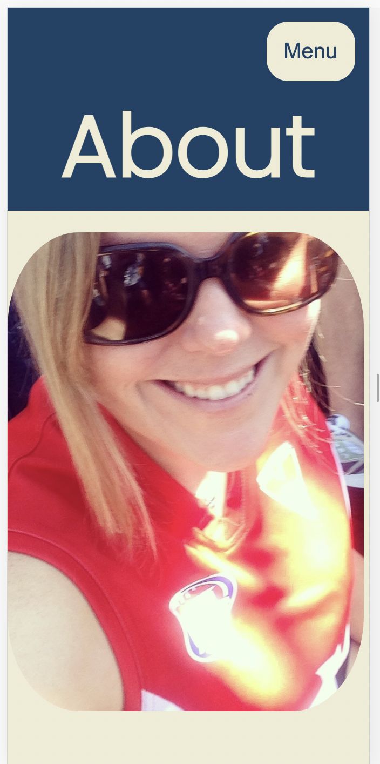
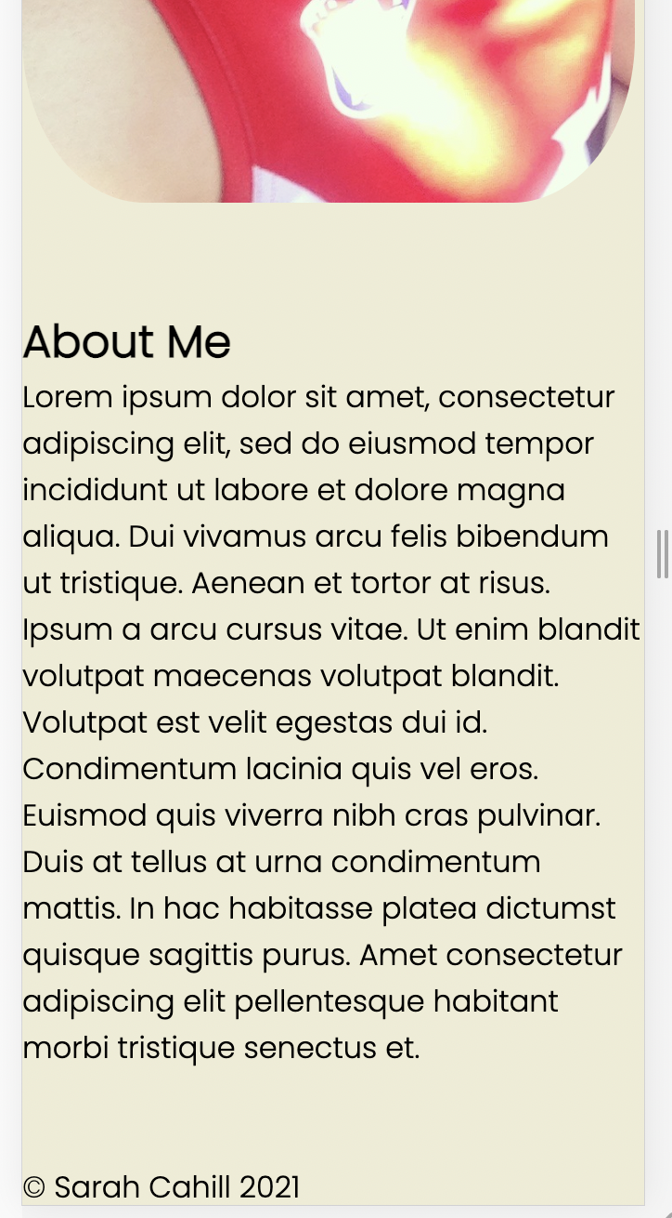
About Page
Used <flex-direction: row> for laptop size, and <flex-direction: column> for phone and ipad.

Slide 9
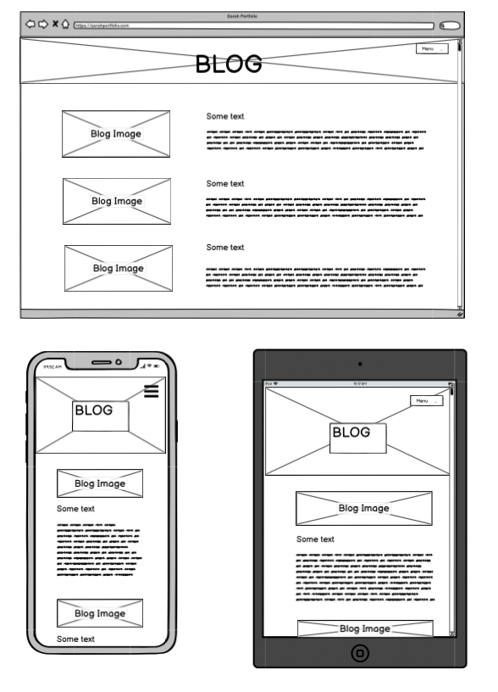
Blog Page
Decided to include all blogs on one page for ease of readability (and save site map from having too many single use pages).
If longer, would have used expand text, to increase interest (by giving user a preview of text to encourage click-through).
Page design differs to other pages in order to show versatility of design.

Slide 10
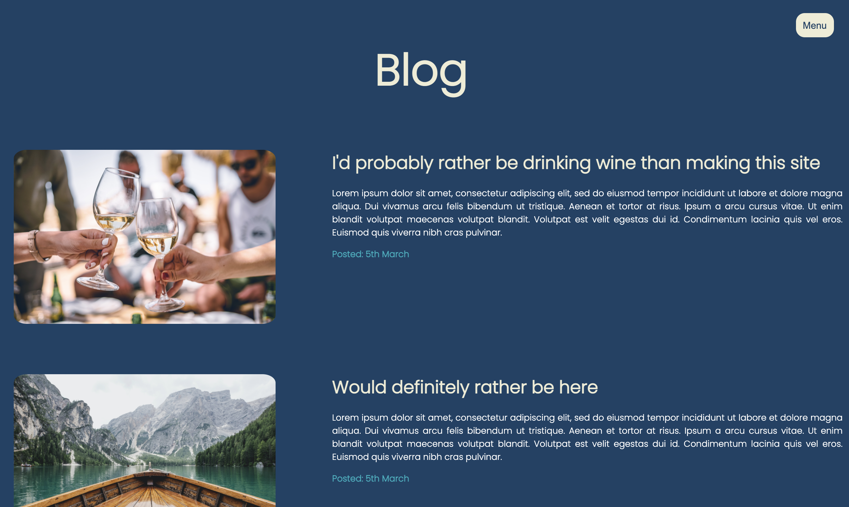
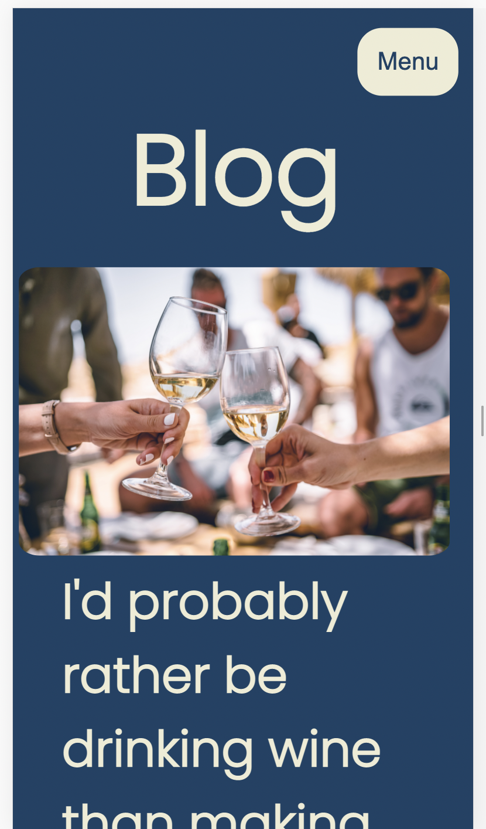
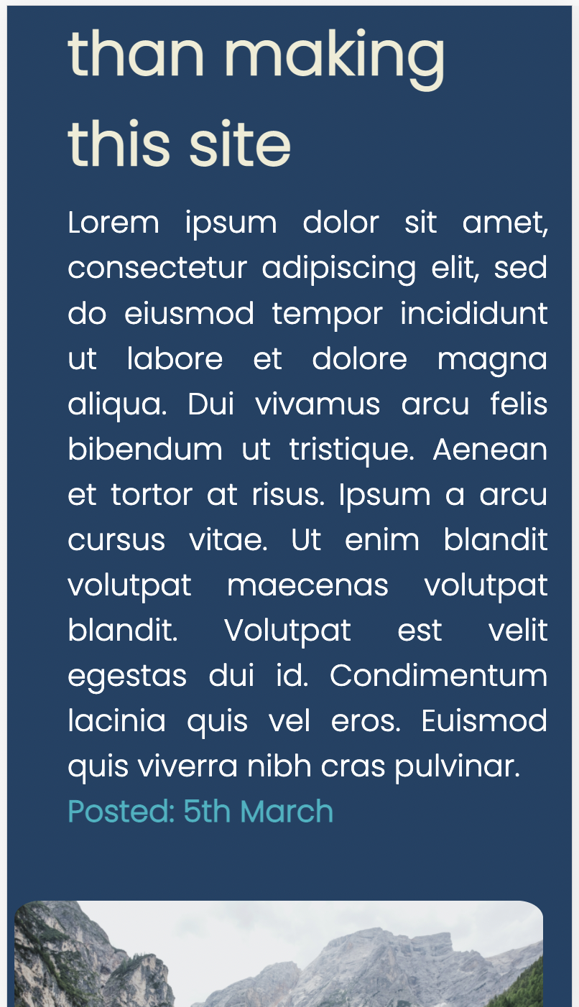
Blog Page
Used dark blue as background colour (as opposed to beige colour on other pages), as this page is more dynamic than informative.
’Date posted’ in different colour.
Again, used <flex-direction: row> for laptop size, and <flex-direction: column> for phone and ipad.

Slide 11
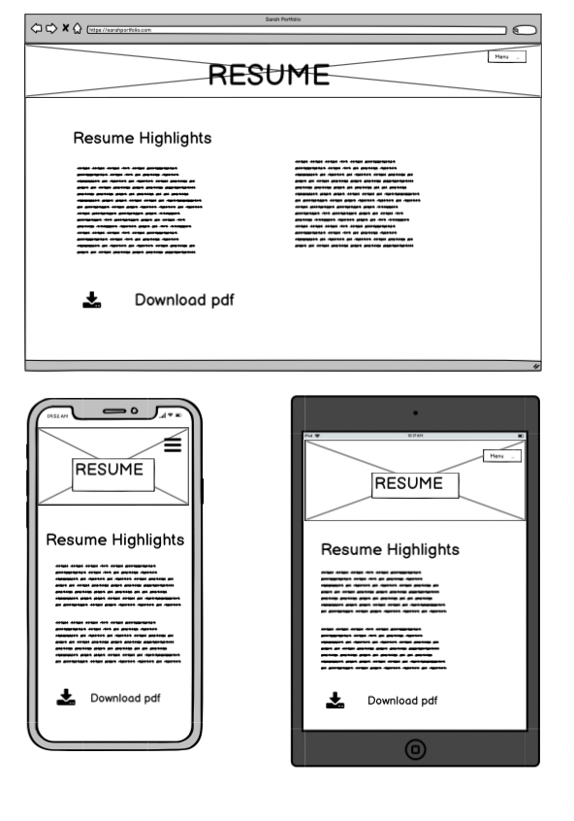
Resume Page
Lists education and job highlights in an <ul>.
Link to download at end.

Slide 12
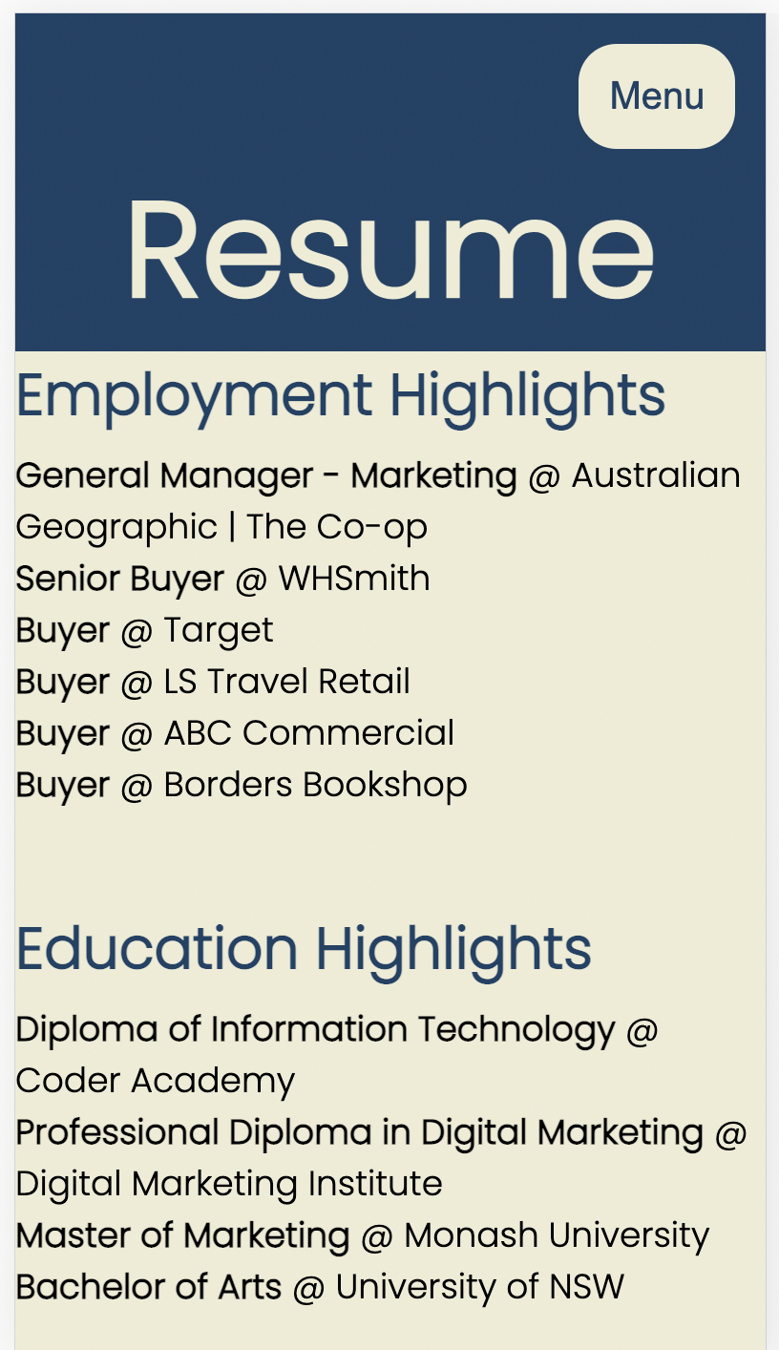
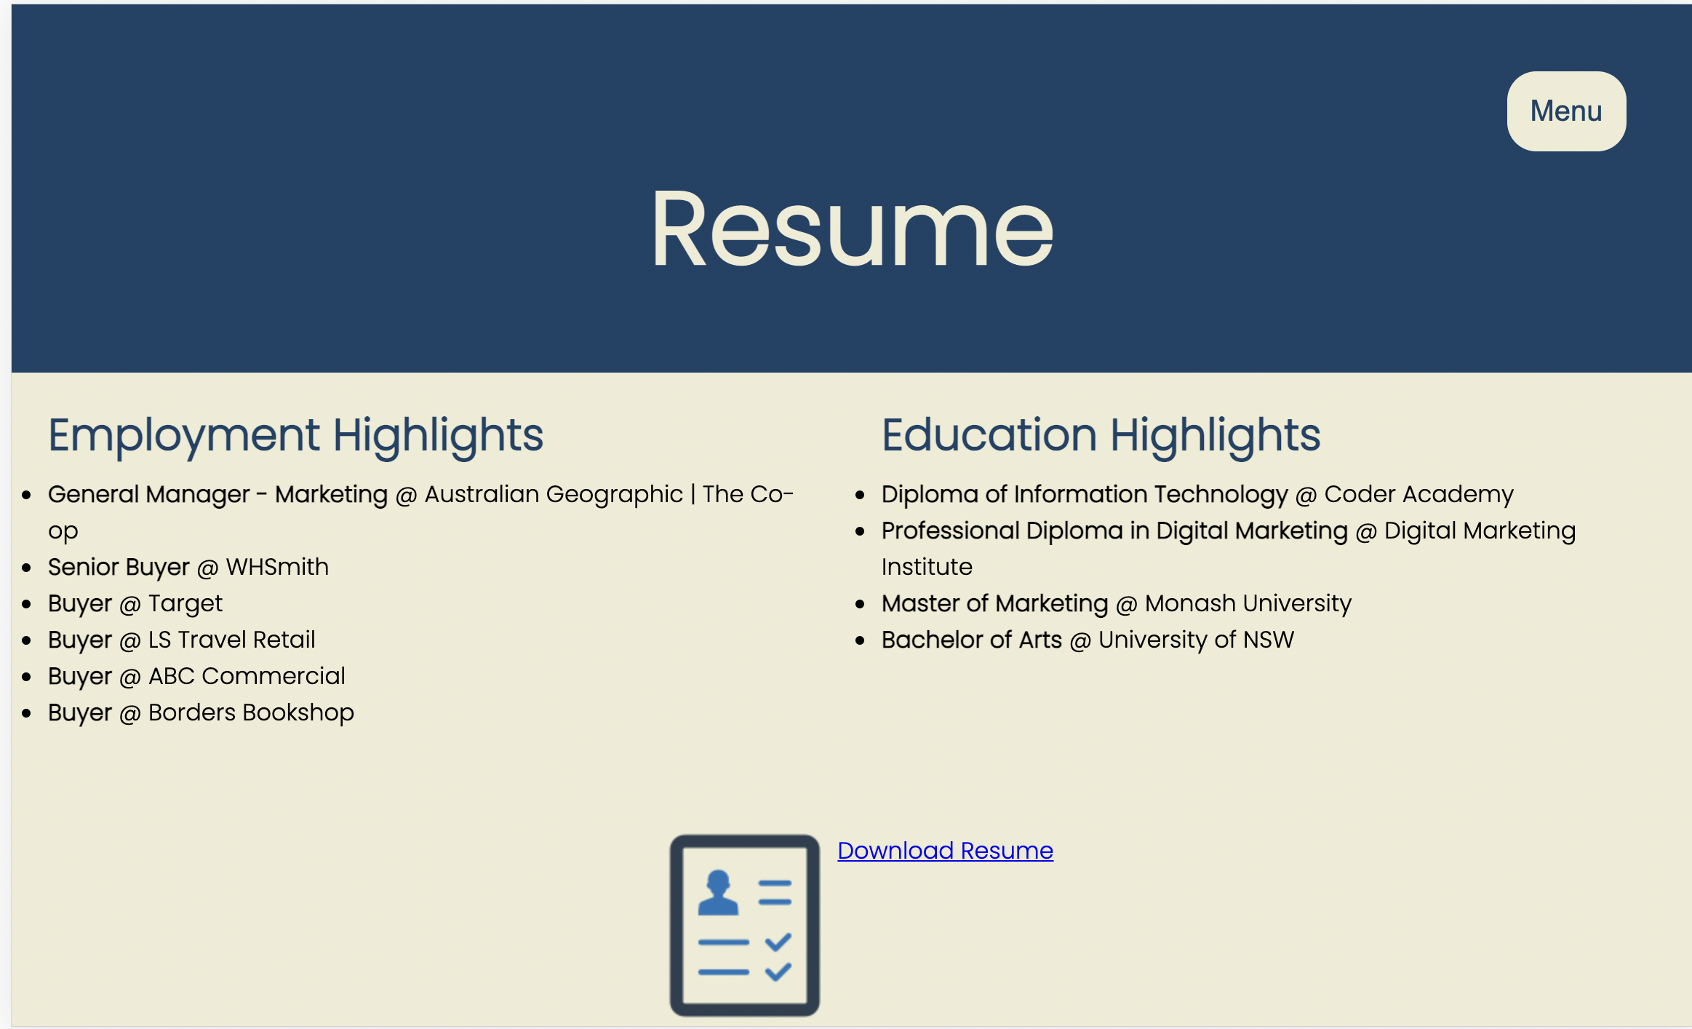
Resume Page
Job titles and degrees/courses as bold, but possibly could stand out more.
Both the resume icon and ‘Download Resume’ will download the pdf.

Slide 13
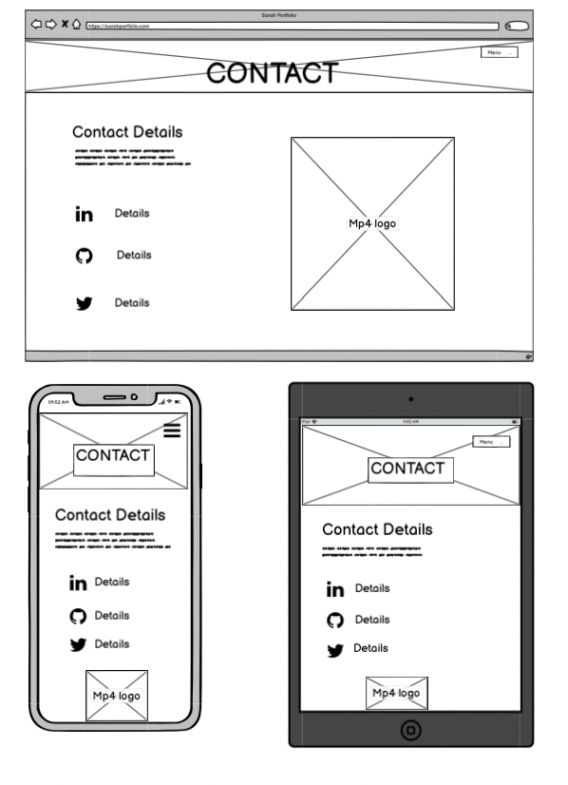
Contact Page
Provides email details.
Uses icons to direct users how to follow.
Includes mp4 version of logo.

Slide 14
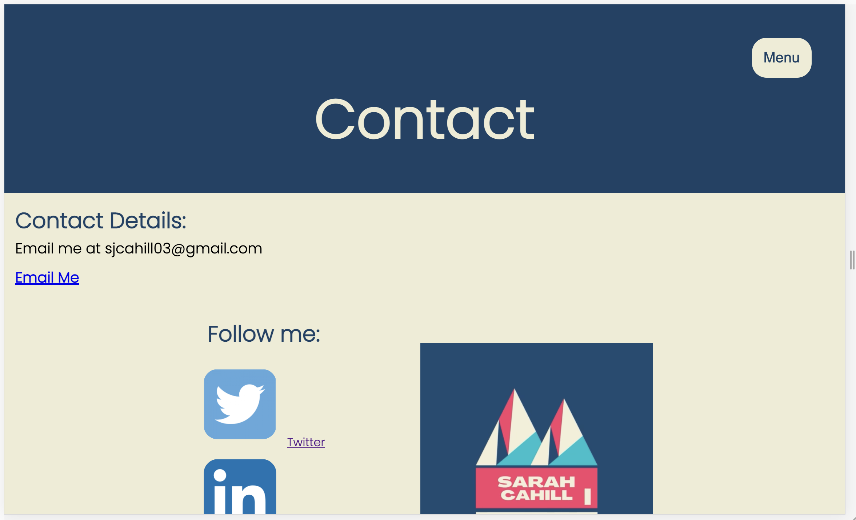
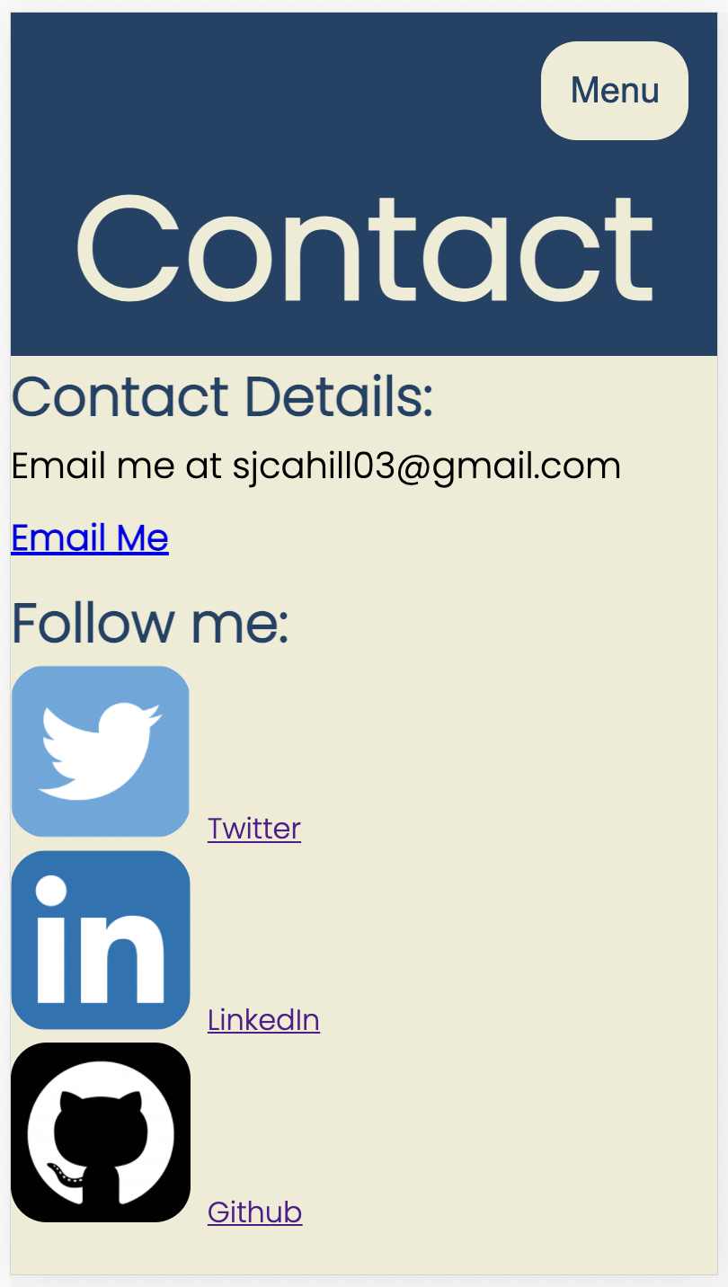

Contact Page
Clicking ‘Email Me’ provides a pop up link to a pre filled email.
Did have full page list next to logos, but changed to word hyperlinks to keep the page cleaner.
Have coded mp4 logo to run on a loop.

Slide 15
Learnings
Obvious, but doing HTML then CSS made a big difference.
Definitely found responsive design the most difficult. Started off in desktop first, then tried mobile first, and is still an ongoing process.
Should use consistency in naming <divs> etc. in HTML between pages.
Make sure ‘go live’ in VS Code is working before making heaps of changes and wondering why they weren’t showing up. Also make sure the preview is zoomed out and look at page without developer tools.
Having the HTML and CSS done without the responsive design is not “almost finished”.

